Slide 1
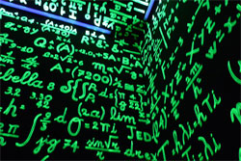
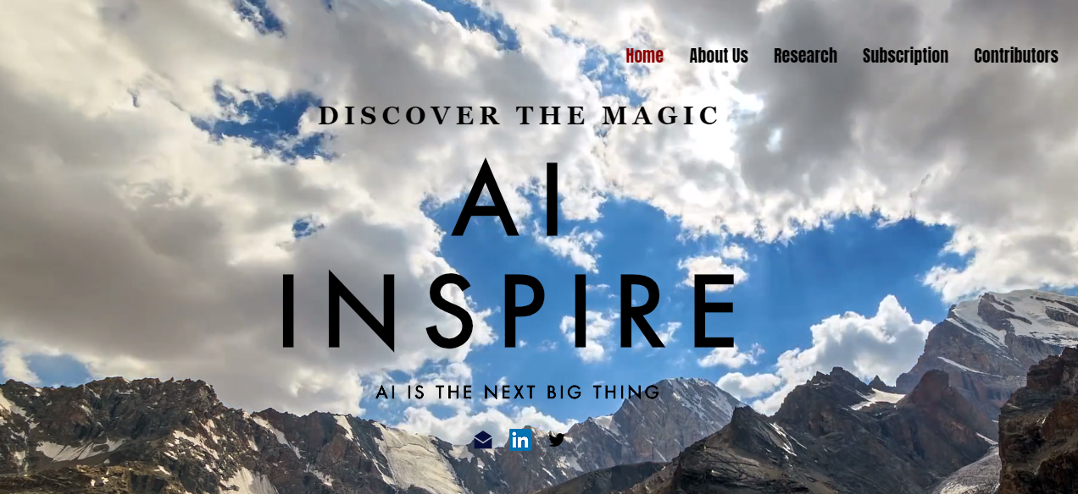
My Background
Who Am I
What I plan to do
AI Inspire Platform
ai-inspire.com

Slide 2
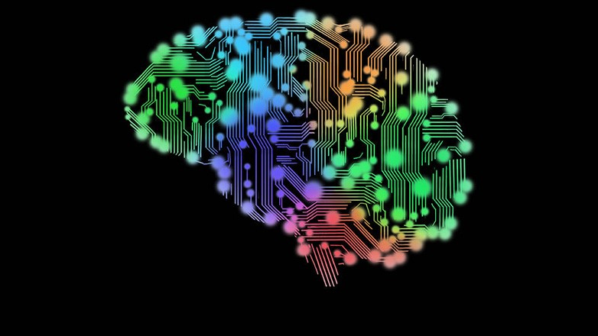
Introduction to Artificial Intelligence

Slide 3
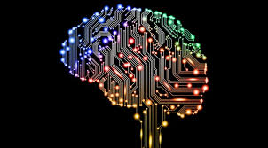
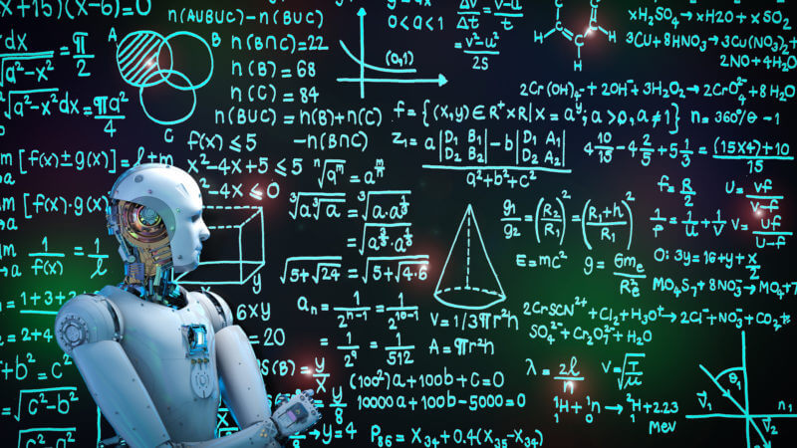
What is AI?
Is this completely NEW?
Field of study : Branch of computer science & math
Objective : create intelligence machines
Training machines
Identifying patterns & making models
Discrete Math : Algorithm analysis
End goal : extend human capabilities

Slide 4
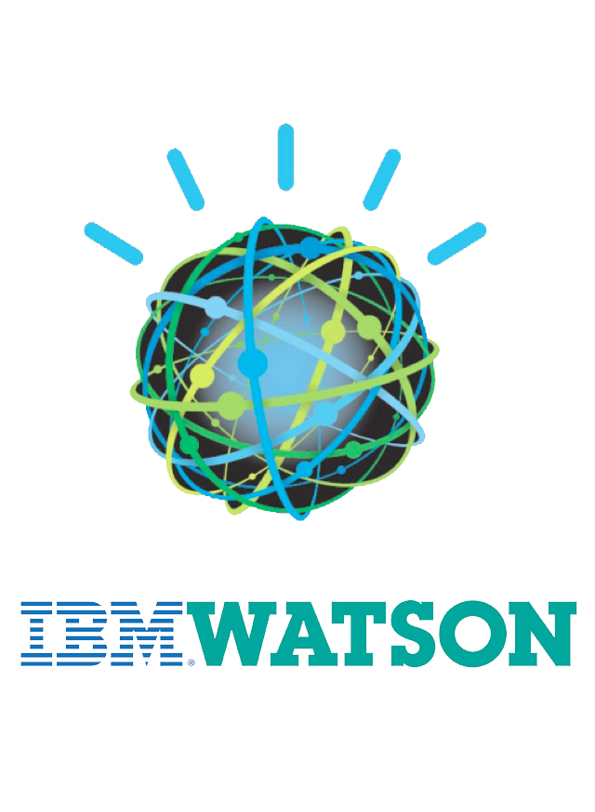

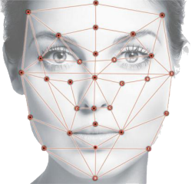

AI Around Us
Assistants
Siri
Alexa
Watson
Galaxy
Cortana
Gmail spam folder
Snapchat filters
Fake news filters
Face Recognition
Notes:
Title “

Slide 5
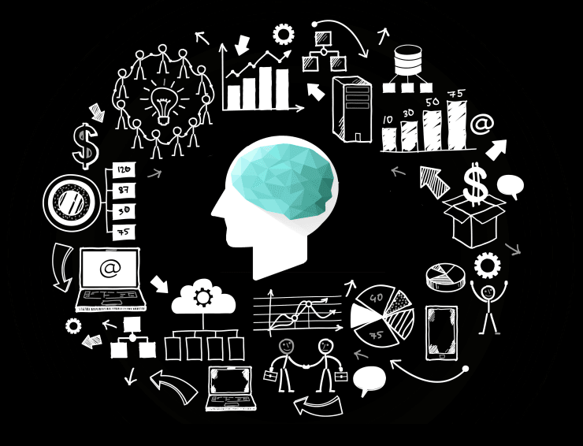
Importance
Broadly used in all diverse fields of study
Real world applications
Achieve more
Friendly user interface
Optimizing pre-existing models
Analyzing data + predicting future
Motivates R&D
Innovation

Slide 6

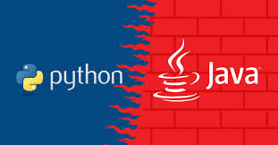

Learning AI
Learn Java
Learn algos & data structures
Learn core AI concepts
Learn 1 statistical-based language : Python or R
Learn some stats
Take part in competitions
Kaggle - D.S.
Make own AI chatbot with NLP!!!!

Slide 7
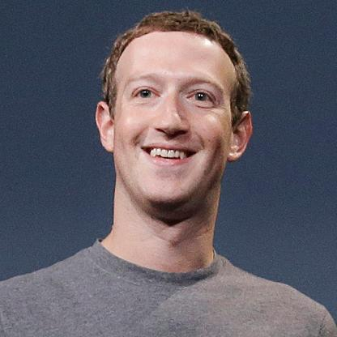
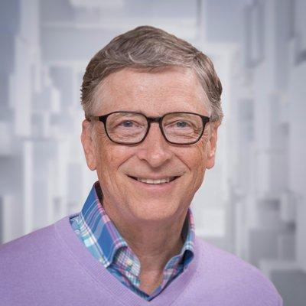
Entrepreneurs
PRO
Bill Gates
Jeff Bezos
Sundar Pichai
Mark Zuckerberg
CON
Elon Musk
Stephen Hawking

Slide 8
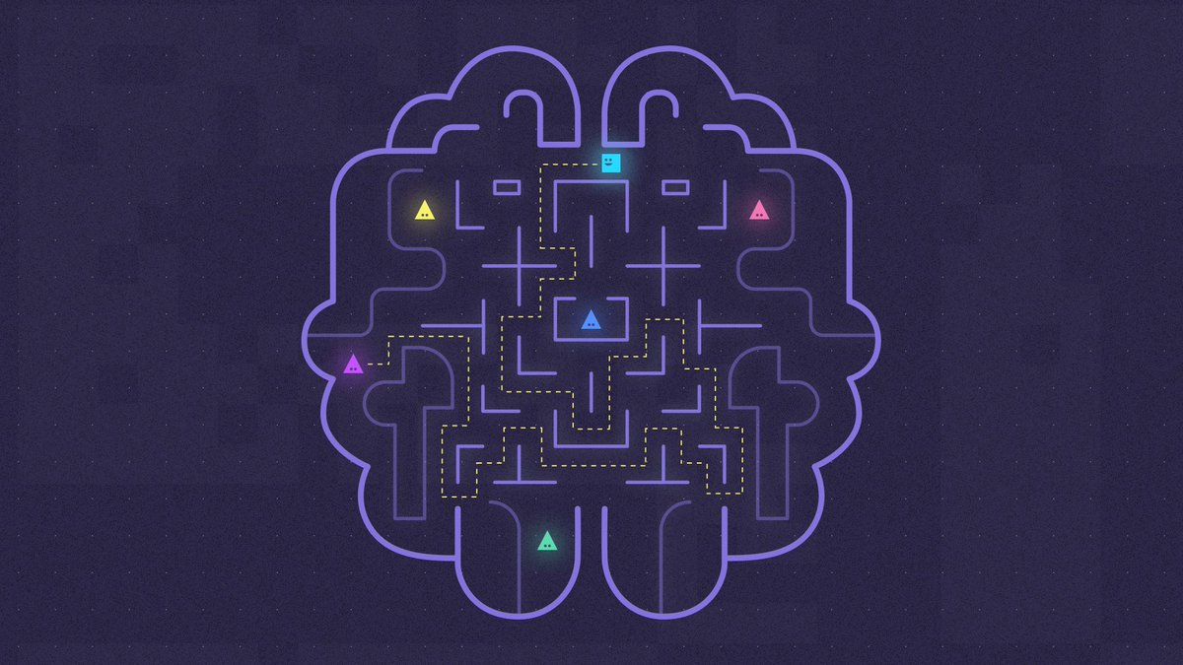
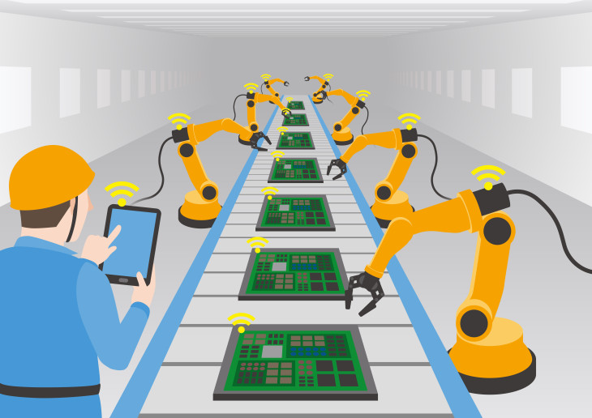
Some Branches of AI
Machine Learning
Pattern recognition models
Natural Language Processing (NLP)
Game Playing
Robotics + Automation
Computer Vision
Image recognition
Smart computer aids for humans

Slide 9
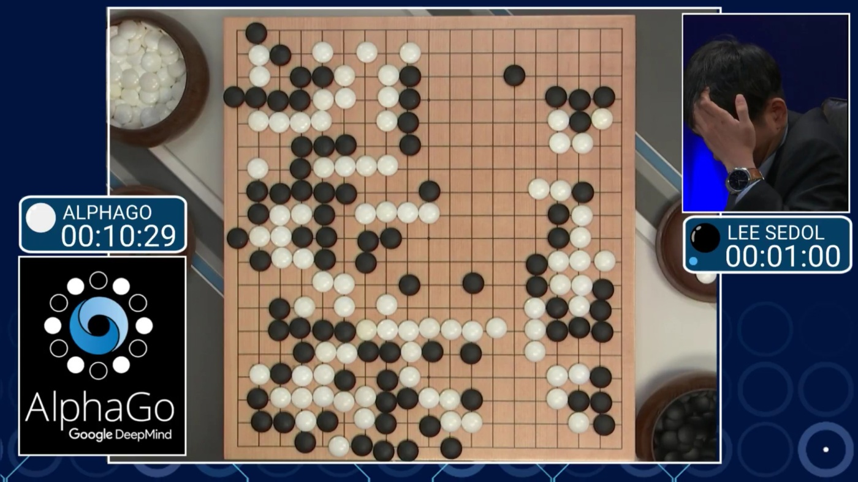
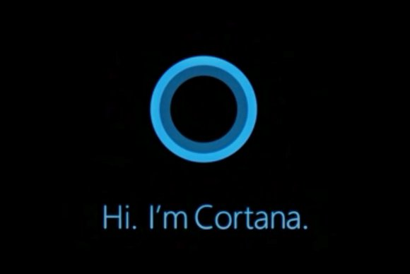
Types of AI
Reactive machines
Don’t store memory, only REACT
Ex : IBM’s Deep Blue & Alpha Go
Limited memory
Ability to observe from past experiences
Not full representations
Theory of mind
Ability to make observations + representations
Self awareness
Form representations of themselves
Notes:
https://theconversation.com/understanding-the-four-types-of-ai-from-reactive-robots-to-self-aware-beings-67616

Slide 10

Let’s Go Back In Time!

Slide 11
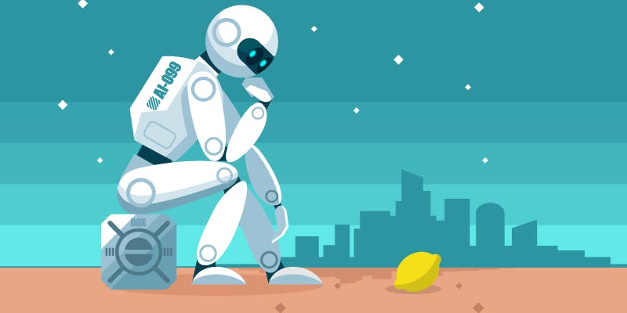
COINED IN 1956!!!!

Slide 12
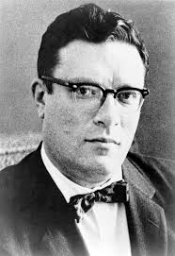
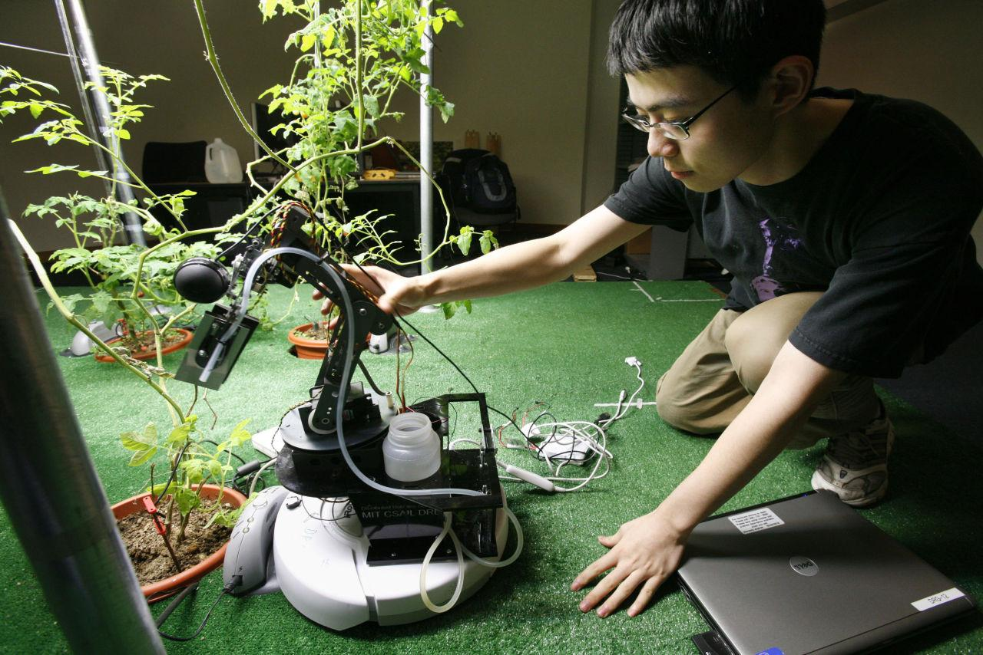
Broad Term
Various definitions
Methods and approaches
Plant, Animal Intelligence
Science Fiction
Isaac Asimov
I, Robot - 1950
Robots for home
Roomba

Slide 13

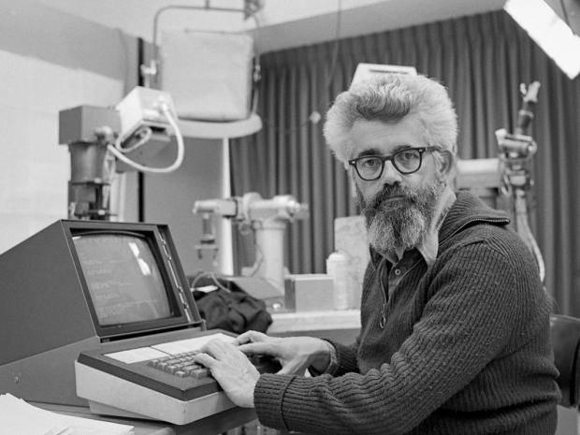
GodFathers & Pioneers
Alan Turing
Computing Machinery & Intelligence
Introduced in 1950
John McCarthy
Ultimate father of AI
SAIL director
Organizer of 1st Dartmouth AI conference
Developed many techniques used today
Primarily specialized in math
Lisp & garbage collection

Slide 14
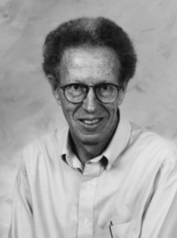
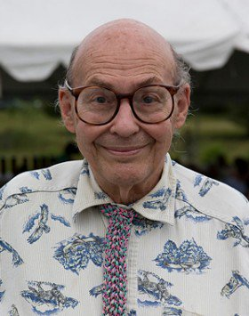
GodFathers & Pioneers (cont.)
Ross Quillian
Semantic Network
Represents relationships in network
Edward Feigenbaum (FROM NJ!!!)
Expert systems
DENDRAL : determining structure of organic molecules
MYCIN : diagnosing blood infections
Merged med/lab with AI
Marvin Minsky
2 main books : commonsense reasoning
SNARC : 1st neural net simulator
Mechanical arms, robotic devices

Slide 15
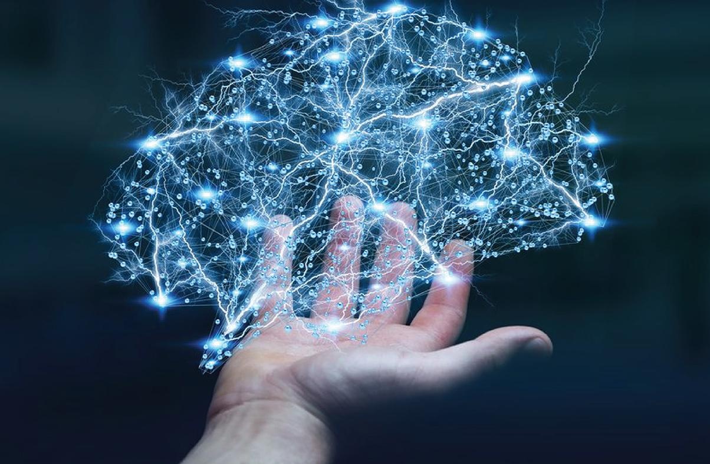
ML Fundamentals

Slide 16
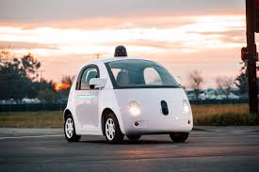
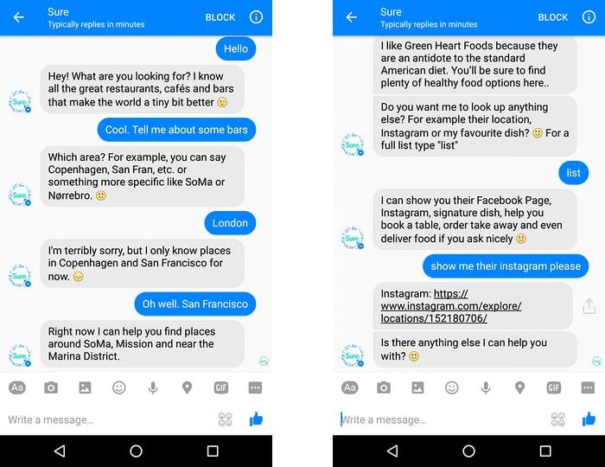
What is ML?
Major branch of AI
Statistical oriented
Objective
TRAIN with data
Models + representing patterns
Not explicitly hard coded

Slide 17

Supervised, Unsupervised, Semi-Supervised Learning
Supervised learning
Both input & output are provided
Algorithm’s goal : analyze given input & output
Unsupervised learning
Goal : observe and analyze input
Without knowing output
Semi supervised learning
Labeled + unlabelled data
Regression, modeling, classification, etc.

Slide 18
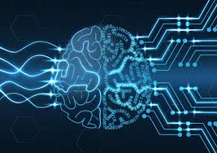
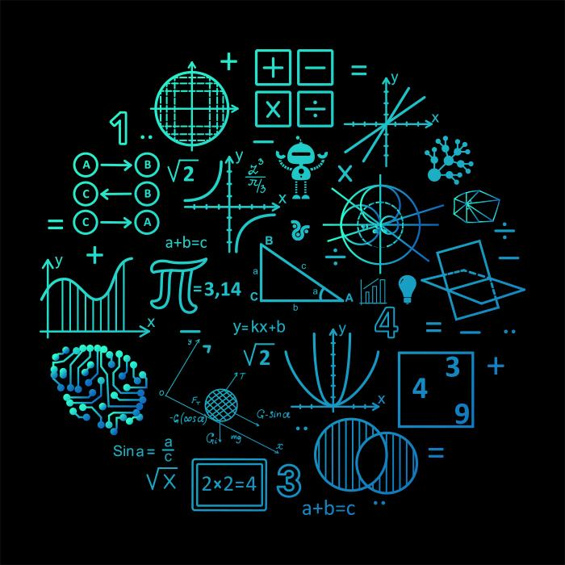
How to Start Creating With ML
Learn Python/R
Learn Stats
Learn Java
Graph Theory
ML Algos
Integrate Core ML in app dev
Understand ML concepts
Amazon Web Services (AWS)
Amazon Machine Learning Model

Slide 19
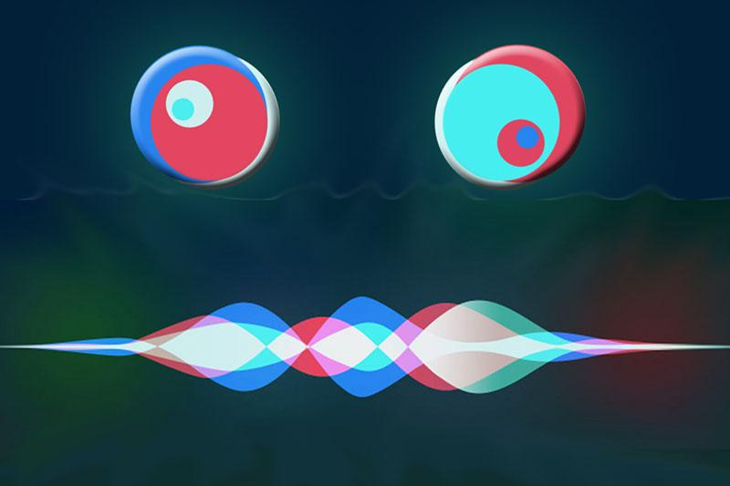
NLP Fundamentals

Slide 20
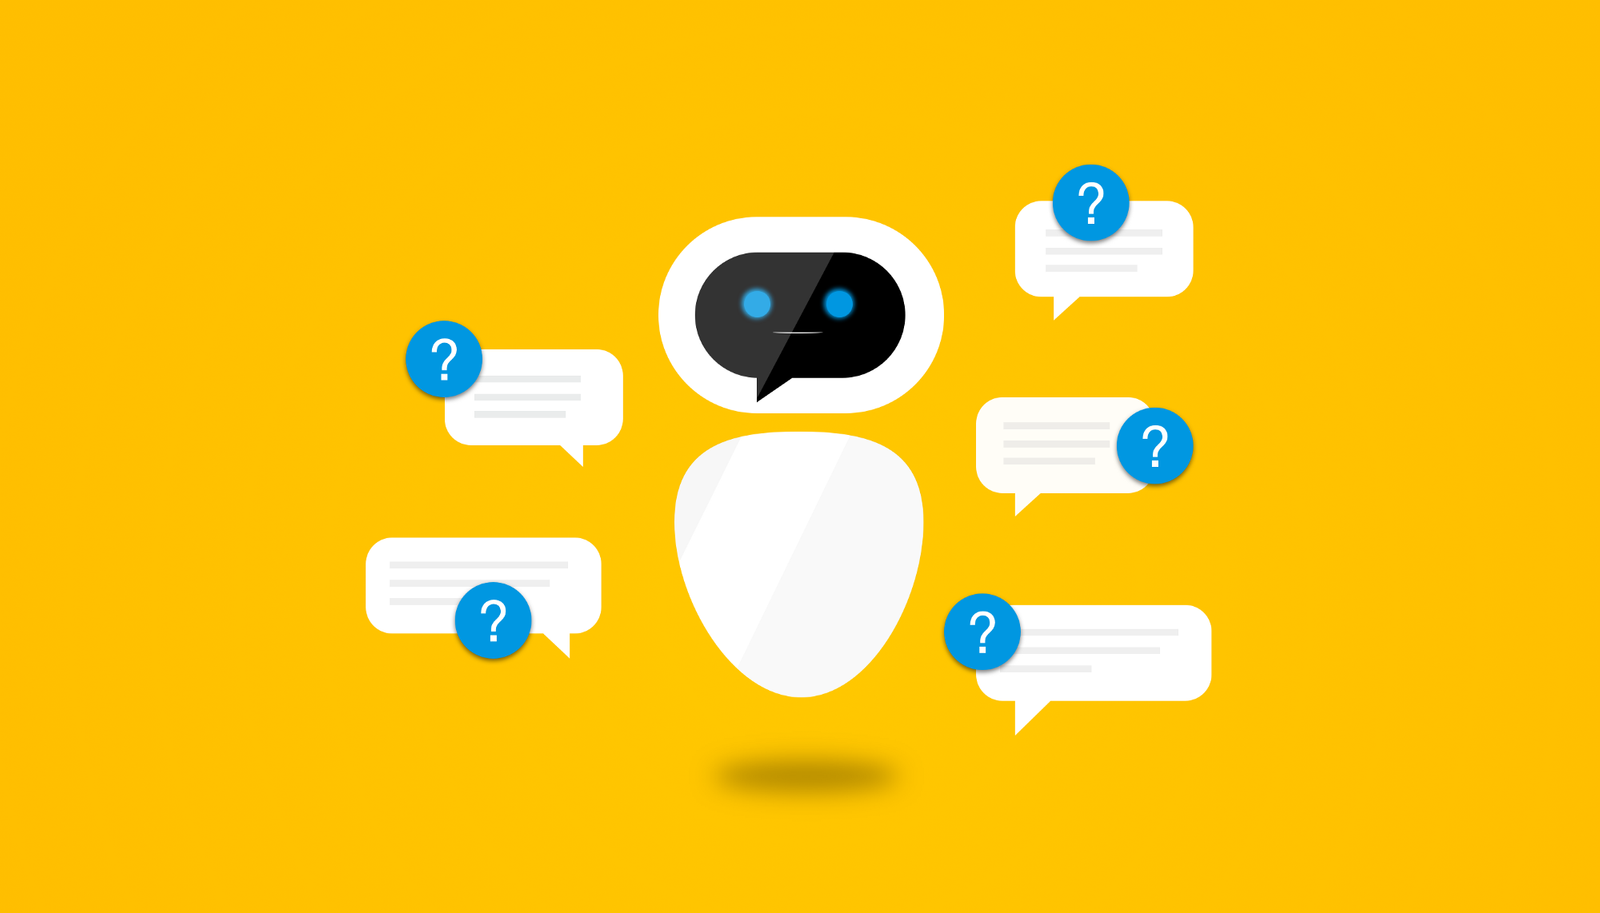
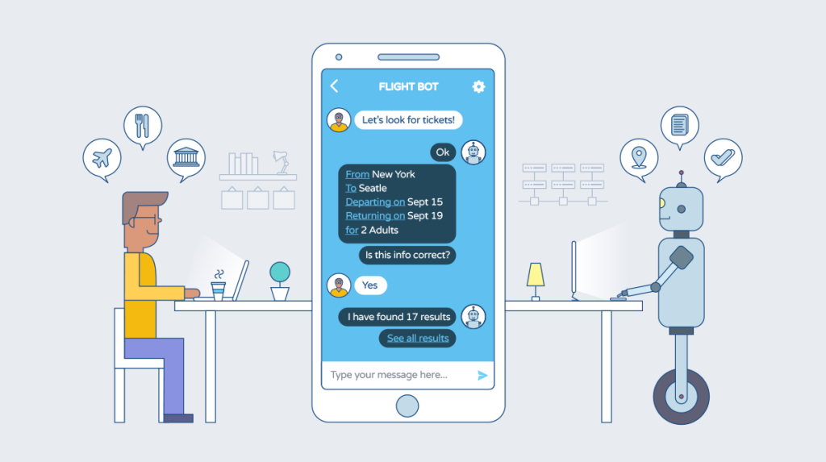
What is NLP?
Analyze + interpret human language
Fake news
Gmail spam filters
Word tokenization
Siri, Cortana, Watson, etc.
APIs for slang language + jargon
Specific slang language for teens vs. adults

Slide 21
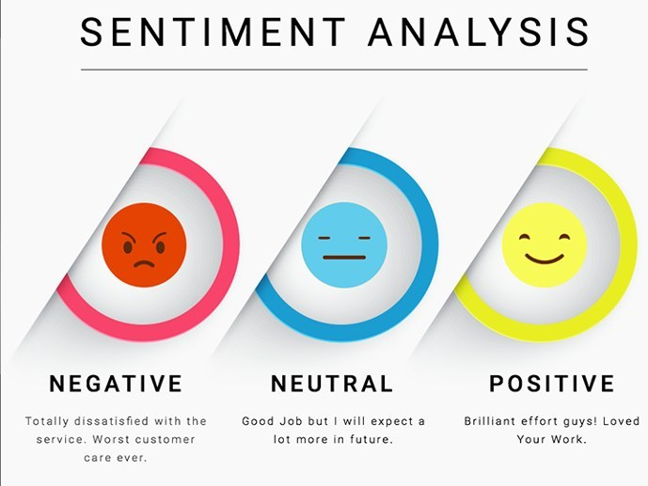
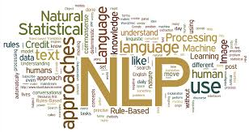
NLP Tasks
POS Identifier
Machine translation
NERD
Named Entity Recognition & Disambiguation
Language Identification
Semantic Parsing
Text Segmentation
Text Summarization
Open Information Extraction
Phrase chunking
Lemmatization
Textual Entailment
Linguistic empathy
Sentiment analyzer
Parsing
Argumentation Mining
Notes:
https://www.quora.com/What-are-the-current-hot-topics-in-natural-language-processing

Slide 22

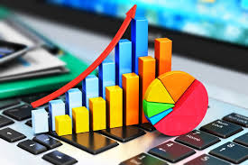
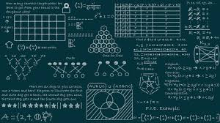
How to Start Creating With NLP
NLP Toolkits & Libraries
Apache OpenNLP
Stanford Core NLP
Learn Python
Learn Java
Learn different NLP algos
Learn statistics + probability

Slide 23
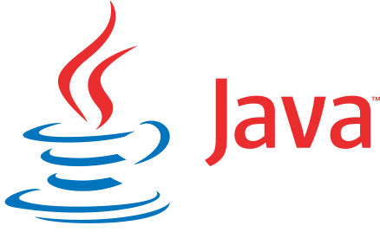
Learning Java

Slide 24
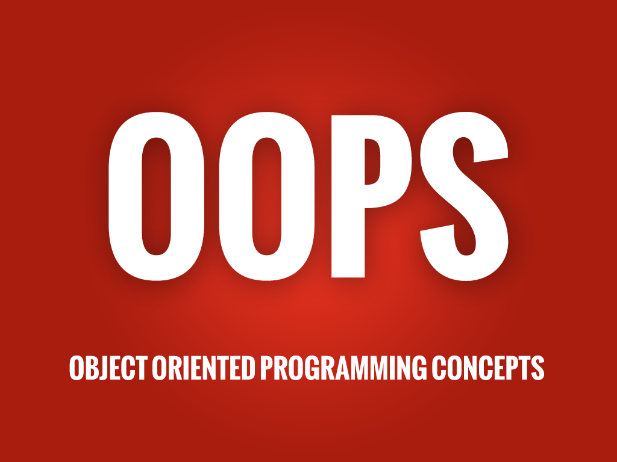
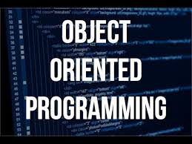
OOP Concepts
Software design
Several advantages over procedural programming
AP Computer Science A
Objective : create relationships between various objects
Abstraction
Encapsulation
Information Hiding
Polymorphism
Inheritance

Slide 25
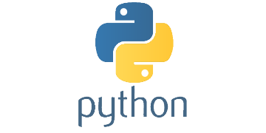
Learning Python

Slide 26
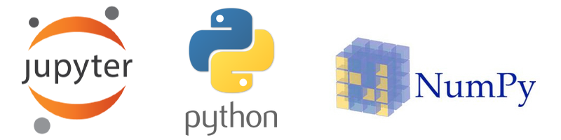

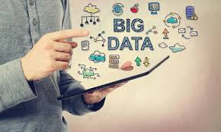
Python
Procedural Programming
Statistical Language
IDEs
PyCharm
Idle
Jupyter
Data Science & Statistics
Stats packages & libraries
Regressions
Data churning

Slide 27

RESOURCES

Slide 28
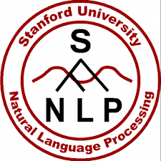
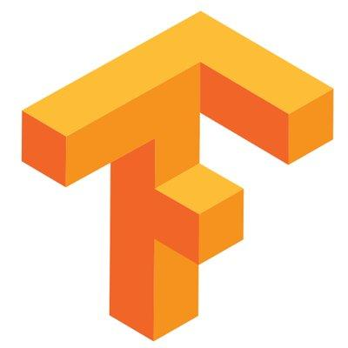
Resources (Not Complete List)
APIs & Libraries
Stanford Core NLP
Apache Open NLP
TENSOR FLOW!!!! -C++ or Python
Python Libraries for DS, AI, and ML
NLTK
Keras
Sci-Kit Learn
Microsoft CNTK
Theano
Spark MLlib
ML Pack

Slide 29


Resources (Not Complete List)
Platforms & IDEs for dev.
Java : Eclipse, IntelliJ, BlueJ for learning
Python : PyCharms, IDLE, Jupyter
C++ : Visual Studio
Use command prompt → installing packages
Competitions
USACO
Kaggle
Hackathons (MLH)

Slide 30
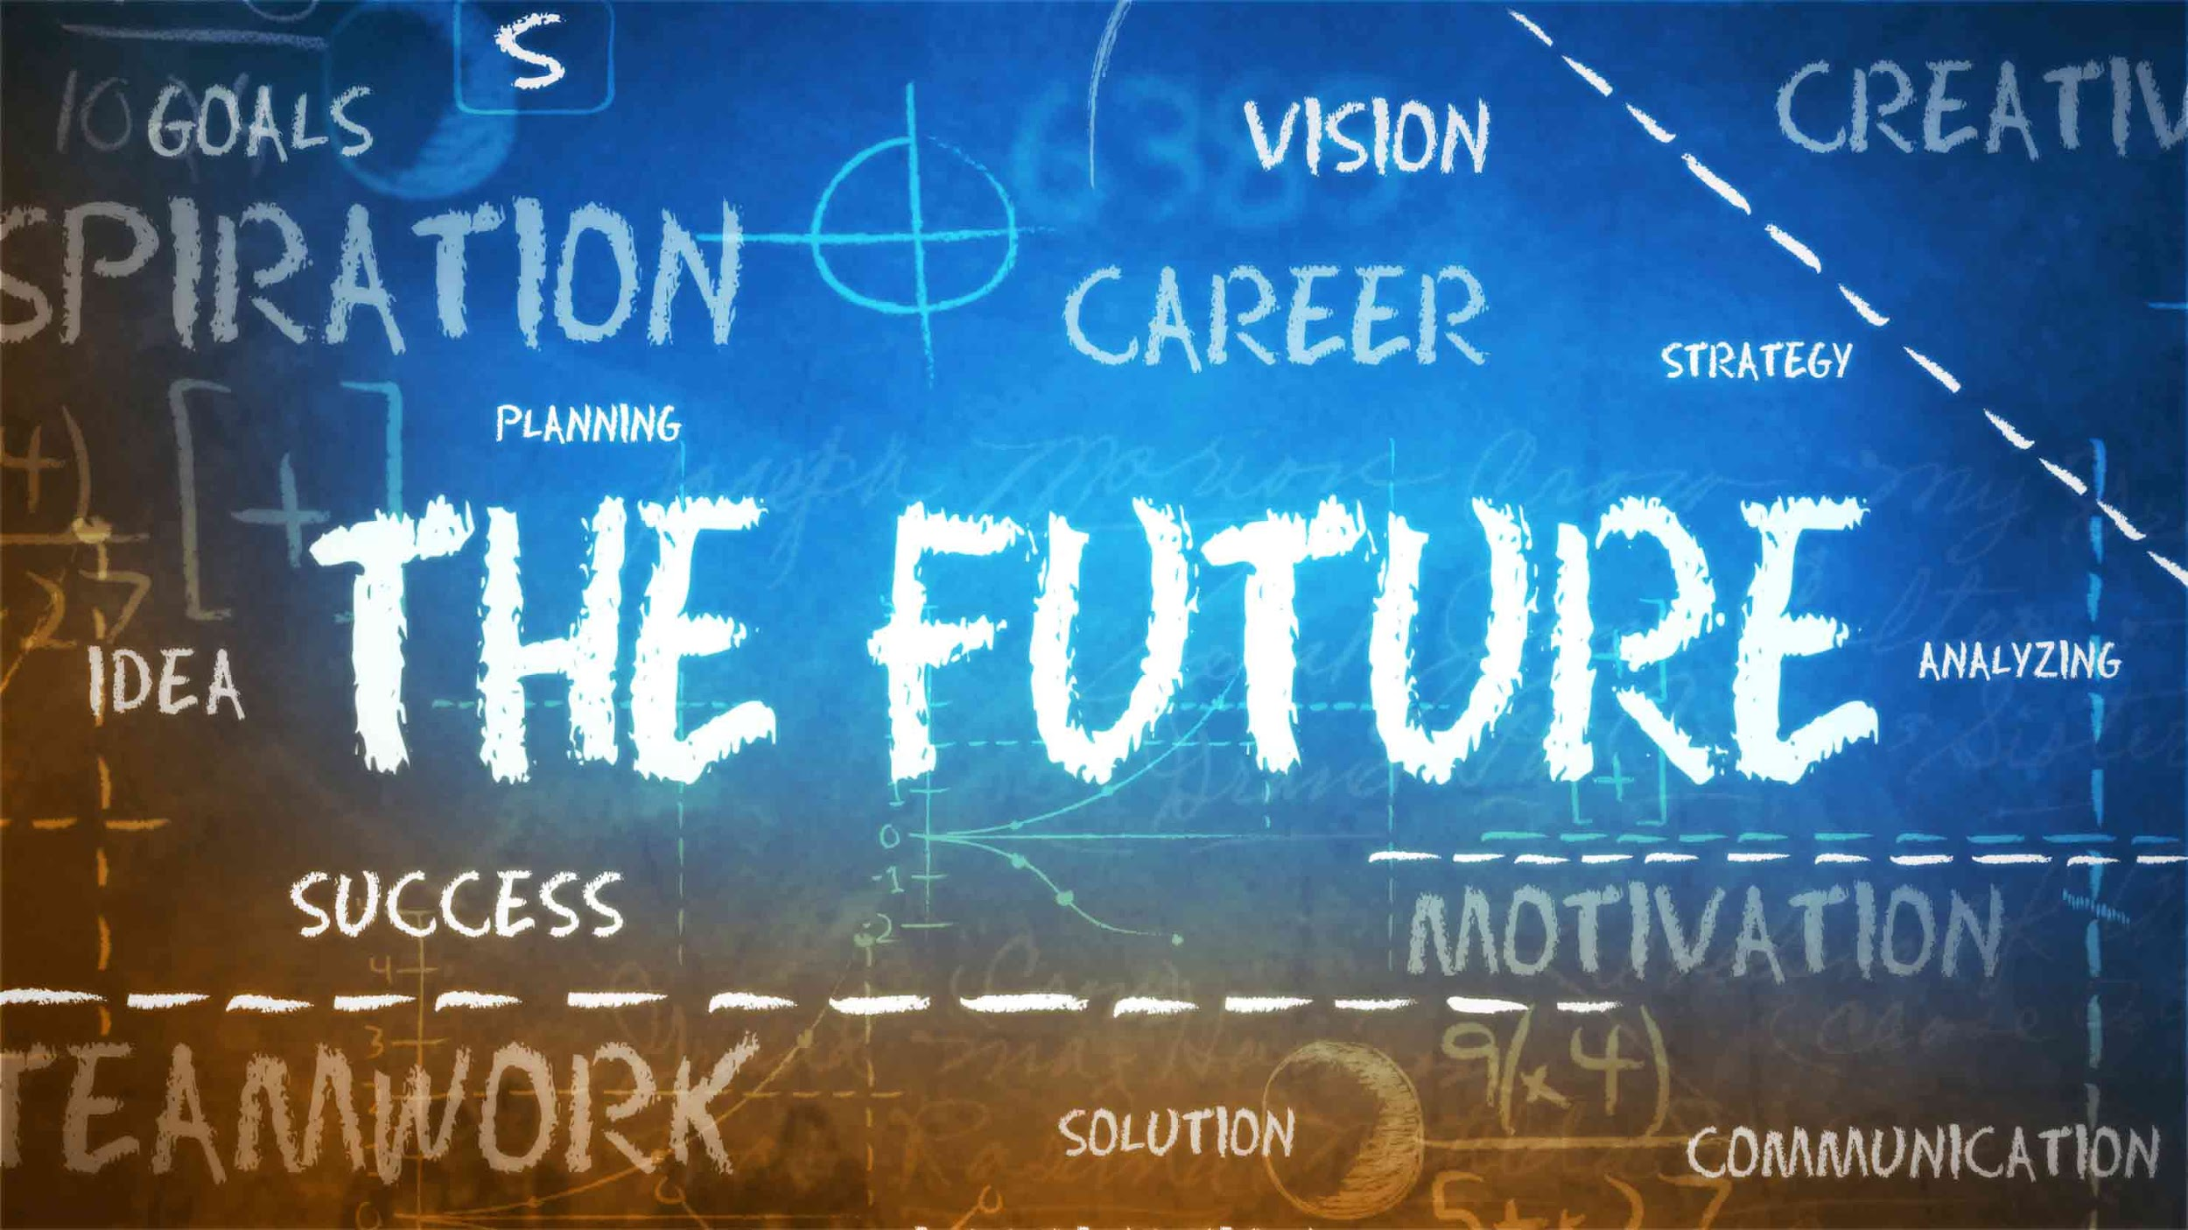
Future Workshops

Slide 31
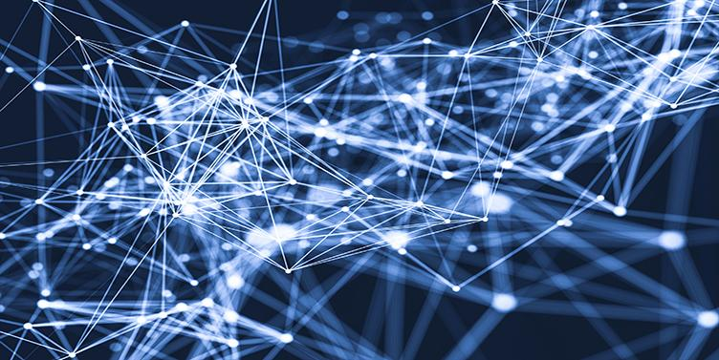
Future Workshops
Week 2 : Natural Language Processing
Week 3 : Graph Theory
Week 4 : Statistics for Machine Learning
Speakers in AI research + domain in future workshops

Slide 32
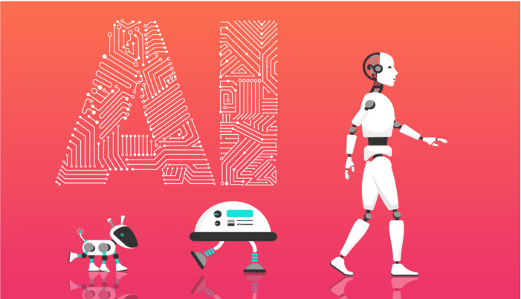

Slide 33
https://www.youtube.com/watch?v=z-EtmaFJieY

